Slide 1
CS144: An Introduction to Computer Networks
Packet Switching

Slide 2
Outline
End-to-end delay
Queueing delay
Simple deterministic queue model
Examples

Slide 3

Propagation Delay, t_{l}: The time it takes a single bit to travel over a link at propagation speed c.
l
Example: A bit takes 5ms to travel 1,000km in an optical fiber with propagation speed 2 x 10⁸ m/s.

Slide 4
Packetization Delay, t_{p}: The time from when the first to the last bit of a packet is transmitted.
p
r bits/s
Example 1: A 64byte packet takes 5.12μs to be transmitted onto a 100Mb/s link.
Example 2: A 1kbit packet takes 1.024s to be transmitted onto a 1kb/s link.

Slide 5
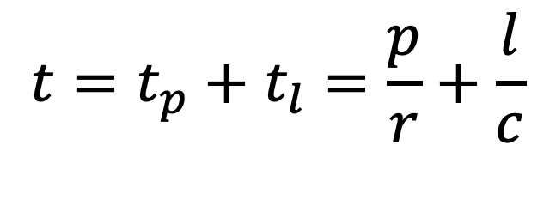
Total time to send a packet across a link: The time from when the first bit is transmitted until the last bit arrives.
l
p
r bits/s
$$t=t_{p}+t_{l}=\frac{p}{r}+\frac{l}{c}$$
Example: A 100bit packet takes 10 + 5 = 15μs to be sent at 10Mb/s over a 1km link.

Slide 6
End-to-end delay
A
l₁, r₁
l₂, r₂
l₃, r₃
l₄, r₄
B
Example: How long will it take a packet of length p to travel from A to B, from when the 1st bit is sent, until the last bit arrives? Assume the switches store-and-forward packets along the path.

Slide 7
A
l₁, r₁
l₂, r₂
l₃, r₃
l₄, r₄
B
S1
S2
S3
A
p/r₁
time
p/r₂
S1
l₁/c
p/r₃
S2
l₂/c
p/r₄
S3
l₃/c
B
l₄/c
time

Slide 8
Data
H
Other packets
A
l₁, r₁
l₂, r₂
l₃, r₃
l₄, r₄
B
S1
S2
Q₂(t)
S3
A
p/r₁
p/r₂
S1
l₁/c
Q₂(t)
p/r₃
S2
l₂/c
p/r₄
S3
l₃/c
B
time
l₄/c

Slide 9
Packet delay variation
CDF (%)
RTT (ms)

Slide 10
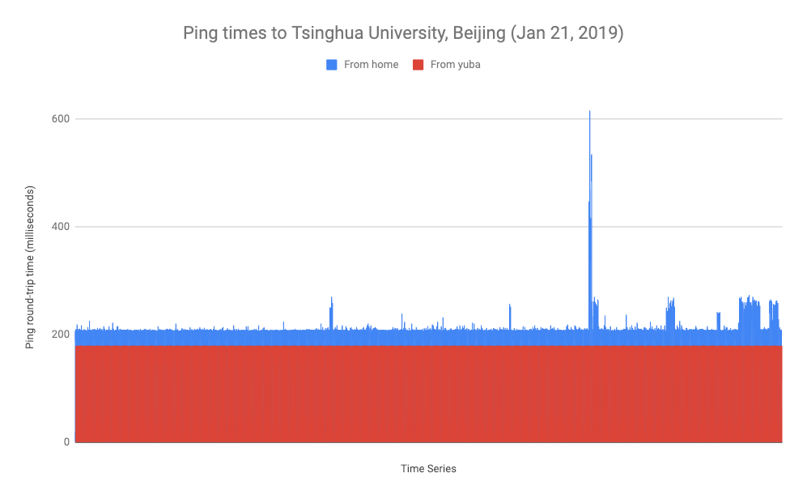

Slide 11
Simple model of a router queue

Slide 12
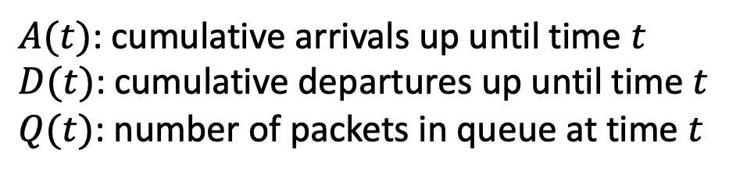
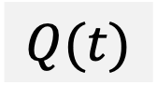
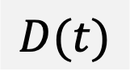
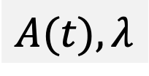
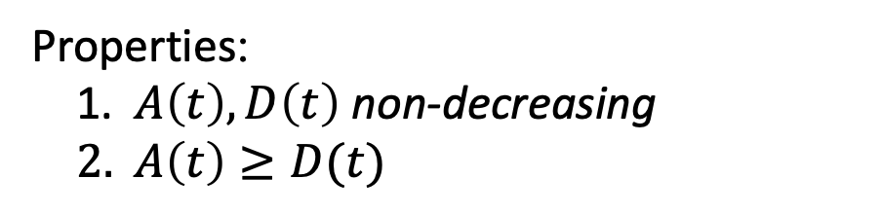
Simple model of a router queue
$A(t)$: cumulative arrivals up until time $t$
$D(t)$: cumulative departures up until time $t$
$Q(t)$: number of packets in queue at time $t$
Router queue
Arriving packets
from different inputs
$$A(t), λ$$
$$D(t)$$
R
$$Q(t)$$
Properties:
$A\left(t\right), D\left(t\right)$ non-decreasing
$A\left(t\right)≥D(t)$

Slide 13
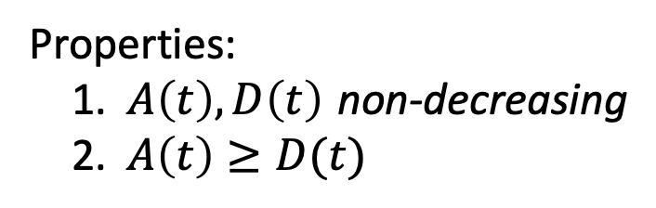
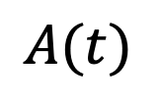
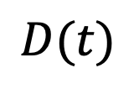
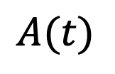
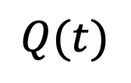
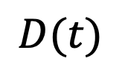
Simple model of a queue
Cumulative number of bytes arrived up until time t.
$$A(t)$$
$$A(t)$$
$$D(t)$$
Cumulative
number of bytes
$$Q(t)$$
R
R
Link
rate
time
$$D(t)$$
Properties:
$A\left(t\right), D\left(t\right)$ non-decreasing
$A\left(t\right)≥D(t)$
Cumulative number of bytes departed up until time t.

Slide 14
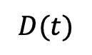
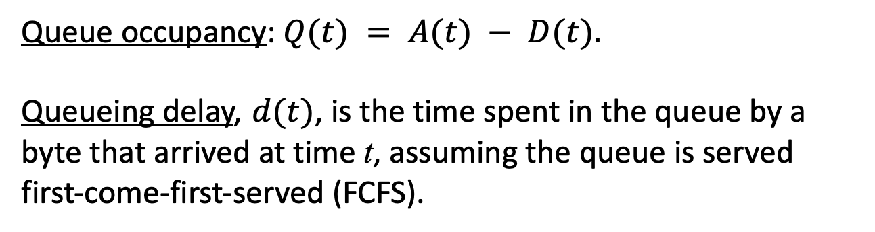
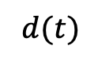
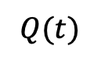
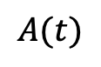
Simple model of a queue
$$A(t)$$
$$D(t)$$
Cumulative
number of bytes
$$d(t)$$
$$Q(t)$$
time
Queue occupancy: $Q(t) = A(t) − D(t).$
Queueing delay, $d(t)$, is the time spent in the queue by a byte that arrived at time t, assuming the queue is served first-come-first-served (FCFS).

Slide 15
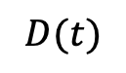
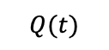
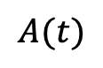
Example (store & forward)
Every second, a 500 bit packet arrives to a queue at rate 10,000b/s. The maximum departure rate is 1,000b/s. What is the average occupancy of the queue?
Cumulative
number of bits
$$A(t)$$
500
$$D(t)$$
$$Q(t)$$
0.05s
0.55s
1.0s
1.05s
time
Solution: During each repeating 1s cycle, the queue fills at rate 10,000b/s for 0.05s, then empties at rate 1,000b/s for 0.5s. Over the first 0.55s, the average queue occupancy is therefore 250 bits. The queue is empty for 0.45s every cycle, and so average queue occupancy is (0.55 * 250) + (0.45 * 0) = 137.5 bits.
Notes:
See worked example video for more details…

Slide 16
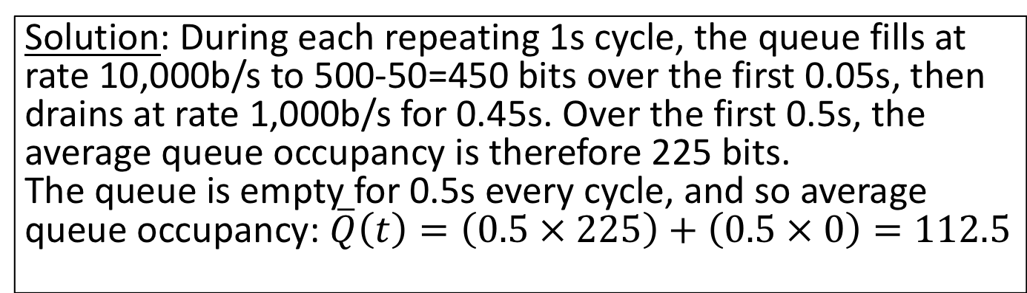
Example (“cut through”)
Cumulative
number of bits
Every second, a 500 bit packet arrives to a queue at rate 10,000b/s. The maximum departure rate is 1,000b/s. What is the time average occupancy of the queue?
A(t)
500
D(t)
Q(t)
0.05s
0.5s
1.0s
time
Solution: During each repeating 1s cycle, the queue fills at rate 10,000b/s to 500-50=450 bits over the first 0.05s, then drains at rate 1,000b/s for 0.45s. Over the first 0.5s, the average queue occupancy is therefore 225 bits.
The queue is empty for 0.5s every cycle, and so average queue occupancy: $\overline{Q}\left(t\right)=\left(0.5 × 225\right)+\left(0.5 × 0\right)=112.5$
Notes:
See worked example video for more details…

Slide 17
What if some packets are more important than others?
Notes:
Up until this point, we have assumed that if packets are queued in a switch, then they are queued in FIFO first-in-first-out order, also known as First Come First Served. In other words, they depart from the queue in the same order they arrive.
In most cases, this makes a lot of sense, and I’m sure it makes intuitive sense to you too. If a packet arrives earlier, then it deserves to leave sooner. And this is how routers usually queue packets: They have a FIFO queue for each egress link, to store packets waiting to depart. Usually we don’t want packets from one user or one application to overtake the packets from another flow. This can get hard to manage if we’re not careful, because you could easily imagine a packet being held back for ever, as other packets keep passing it by.
As a simple thought experiment, imagine if queues were arranged as LIFO, or last in first out, instead. If we did that – and I’m the first to admit it would be kind of crazy to do it this way – then packets arriving later would always pass by packets that arrived earlier and are still stuck in the queue. Packets could potentially be stuck in the queue forever, even if the queue doesn’t overflow.
But some times it’s important to treat packets differently, when some packets are more important than others. That’s the topic of this video….

Slide 18
By default, switches and routers use FIFO (aka FCFS) queues
Buffer size, B
Packets arriving to different ingress ports
Service Rate, R
Departing
packets
Notes:
And so for fairly natural reasons, most queues are kept in FIFO order. FIFO queues, like the one shown here, have a nice property that we will take advantage of later: If you want to know how long an arriving packet will wait in a FIFO queue, you only need to know the occupancy of the queue when it arrived (i.e. how many packets are ahead of it waiting to depart), and the service rate of the queue. We will see later how we use this to guarantee the delay of a packet across a whole network of packet switches.
But I’m getting ahead of myself…... before we get to that, I want you to think about the downsides of FIFO queues. First, and perhaps most obviously, everyone is treated equally. Your packets arrive at the tail of the queue <click,click>, and you leave from the head <click>. Often this is a good thing.

Slide 19
By default, switches and routers use FIFO (aka FCFS) queues
Buffer size, B
Packets arriving to different ingress ports
Service Rate, R
Departing
packets
Notes:
But if different flows with different levels of importance, you might want some to jump ahead in the queue <click, click>. For example, imagine a network carrying free-service red packets for some customers and premium-service blue packets for other customers who pay more. In this case, it makes sense for the blue traffic to jump ahead. Or perhaps we want the control traffic that keeps the network operating to take precedence over the regular data traffic. Whatever reason we might have to give some traffic priority over other traffic, a FIFO queue isn’t much help, because it simply serves the packets in the order they were received.

Slide 20
Some packets are more important
For example:
The control traffic that keeps the network working (e.g. packets carrying routing table updates)
Traffic from a particular user (e.g. a customer paying more)
Traffic belonging to a particular application (e.g. videoconference)
Traffic to/from particular IP addresses (e.g. emergency services)
Traffic that is time sensitive (e.g. clock updates)
Notes:
In summary, we might consider some packets to be more important because:
For example:
The control traffic that keeps the network working (e.g. packets carrying routing table updates)
Traffic from a particular user (e.g. a customer paying more)
Traffic belonging to a particular application (e.g. videoconference)
Traffic to/from particular IP addresses (e.g. emergency services)
Traffic that is time sensitive (e.g. clock updates)
Another less obvious drawback of a FIFO queue is what is known as “the tragedy of the commons”.

Slide 21
Flows
When talking about priorities, it’s convenient to talk about a “flow” of packets that all share a common set of attributes. For example:
The flow of packets all belonging to the same TCP connection Identified by the tuple: TCP port numbers, IP addresses, TCP protocol
The flow of packets all destined to Stanford Identified by a destination IP address belonging to prefix 171.64/16
The flow of packets all coming from Google Identified by a source IP address belonging to the set of prefixes Google owns.
The flow of web packets using the http protocol Identified by packets with TCP port number = 80
The flow of packets belonging to gold-service customers Typically identified by marking the IP TOS (type of service) field
Notes:
Before we go further, a quick word about flows.
When talking about priorities, it’s convenient to talk about a “flow” of packets that all share a common set of attributes. For example:
The flow of packets all belonging to the same TCP connection. THIS is the most common definition of a flow, although all the other ones below make sense too. Identified by the tuple: TCP port numbers, IP addresses, TCP protocol
The flow of packets all destined to Stanford Identified by a destination IP address belonging to prefix 171.64/16
The flow of packets all coming from Google Identified by a source IP address belonging to the set of prefixes Google owns.
The flow of web packets using the http protocol Identified by packets with TCP port number = 80
The flow of packets belonging to gold-service customers Typically identified by marking the IP TOS (type of service) field
Returning to the limitations of a FIFO queue, the bottom line is that with a FIFO queue, we can’t say anything about the rate each individual flow will depart, how long they are queued, and the incentive scheme makes it more likely it will be congested and drop our packets.

Slide 22
Outline
Strict Priorities
Weighted Priorities and Rate Guarantees
Notes:
In this video we are going to look at two different, but relatively simple ways to queue packets, and schedule their departure. The first is to keep different FIFO queues, one for each priority level. The second is to give different flows a different rate, and guarantee a minimum rate of service for every flow.
We will start with priority queues….

Slide 23
Strict Priorities
High priority flows
Low priority flows
Notes:
Let’s start by considering strict priority queues with the following packets. We’ll let the packets arrive then freeze the queues so we can see what’s going on.

Slide 24
Strict Priorities
High priority flows
Low priority flows
“Strict priorities” means a queue is only served when all the higher priority queues are empty
Notes:
With strict priority queues traffic in one queue has strict priority over the traffic in the other queue. This means the red, low-priority queue is only served when the blue queue is empty.

Slide 25
Strict Priorities: Things to bear in mind
Strict priorities can be used with any number of queues.
Strict priorities means a queue is only served when all the higher priority queues are empty.
Highest priority flows “see” a network with no lower priority traffic.
Higher priority flows can permanently block lower priority flows. Try to limit the amount of high priority traffic.
Not likely to work well if you can’t control the amount of high priority traffic.
Or if you really want weighted (instead of strict) priority.
Notes:
Strict priorities can be used with any number of queues, supporting multiple classes of service for different types of traffic. The algorithm extends naturally to multiple queues: a queue is only served when all the higher priority queues are empty.
One way to think about strict priorities is that the <click> highest priority flows “see” a network with no lower priority traffic.
One thing to watch out for is that <click> higher priority flows can permanently block lower priority flows, so you should try to limit the amount of high priority traffic.
And it’s <click> Not likely to work well if you can’t control the amount of high priority traffic.
In fact, you may not really want strict priorities at all. Instead, you might <click> really want weighted (instead of strict) priority.

Slide 26
How do I give weighted (instead of strict) priority?
Notes:
So how can a packet switched network give weighted priorities between two or more flows, instead of just strict priority?

Slide 27
Notes:
Let me explain what I mean by way of an example. Let’s say we have these red and blue packets in their own queues…..

Slide 28
Trying to treat flows equally
Notes:
…and we want to give each flow an equal fair share of the egress link capacity. In other words, I want them to get half each.
A very natural way would be to take alternate packets from each queue. A blue one, then a red one, then a blue one and so on...

Slide 29
Trying to treat flows equally
While each flow gets to send at the same packet rate,
the data rate is far from equal.
Notes:
The problem with this approach is pretty clear: While each flow gets to send at the same packet rate, the data rate is far from equal. That’s because the big blue packets take more than their fair share of the bit rate. This is going to be a problem in general, because packet lengths are variable, and the queues could be filled with a whole variety of different packet lengths.
What should we do?

Slide 30
Scheduling flows bit-by-bit
Notes:
What we really want is for an equal number of red and blue bits to be placed on the outgoing link, like this. This guarantees we always guarantees the two flows get an equal share of the outgoing link.

Slide 31
Scheduling flows bit-by-bit
Now each flow gets to send at the same data rate,
but we no longer have “packet switching”.
Notes:
But of course this has a problem too: While each flow gets to send at the same data rate, we no longer have packet switching, because we’ve broken up the packets into bits.

Slide 32
Can we combine the best of both?
i.e. packet switching, but with bit-by-bit accounting?
Notes:
So here’s the key question of this video: Can we combine the best of both. In other words, can we use packet switching, but get the benefits of bit by bit fair sharing of the link?
The answer is yes, and next I’m going to explain how.

Slide 33
Fair Queueing
3
2
1
5
2
4
3
1
2
1
6
5
4
3
2
1
5
2
4
3
1
2
1
Packets are sent in the order they would complete in the bit-by-bit scheme.
Does this give fair (i.e. equal) share of the data rate?
Notes:
What if we look at the time the packets *would* have finished if we were sending them bit by bit. For example, the first red packet would finish here <click> because it’s 4 bits long. The next few red packets complete at these times <click>. The blue packets finish at these times. <click>
Now, because the first red packet finishes first, we are going to send it first. The next packet to finish is also a red packet, so we send its bits next. The next packet to finish is a blue packet, so we send its bits next, and so on for red packets and blue packet. At the end, we are left with a couple of bits from the next blue packet, and they will be sent with the rest of the blue packet when it’s ready to depart. You can see that this scheme is designed to take into consideration both the bit rate and the fact that we need to send packets. This scheme is called Fair Queueing.
<click> Packets are sent in the order they would complete in the bit-by-bit scheme.
The big question is: Does this give fair and equal share of the data rate?

Slide 34
Yes!
It can be proved that the departure time of a packet with Fair Queueing is no more than L_{max}/R seconds later than if it was scheduled bit-by-bit. Where L_{max} is the maximum length packet and R is the data rate of the outgoing link.
In the limit, the two flows receive equal share of the data rate.
The result extends to any number of flows sharing a link.¹
[1] “Analysis and Simulation of a Fair Queueing Algorithm” Demers, Keshav, Shenker. 1990.
Notes:
The answer is Yes – Fair queueing gives equal share bit rate to both.
In fact, It can be proved that the departure time of a packet with Fair Queueing is no more than L_{max}/R seconds later than if it was scheduled bit-by-bit. Where L_{max} is the maximum length packet and R is the data rate of the outgoing link.
This means that in the limit, the two flows receive equal share of the data rate.
The result extends to any number of flows sharing a link. If you’d like to learn more about Fair Queueing, and read the main proof that it works, then you can find this paper on the web.
Now we know how to give an equal fair share to flows, what if we want to give an unequal fair share?

Slide 35
What if we want to give a different share of the link to each flow?
i.e., a weighted fair share.
Notes:
In other words, What is we want to give a different share of the link to each flow? A weighted fair share of the link.

Slide 36
Weighted Fair Queueing
3
2
1
3/4
3
2
2
1
1
6
5
4
3
2
1
3
2
2
1
1
1/4
As before, packets are sent in the order they would complete in the bit-by-bit scheme.
Notes:
This variant is called Weighted Fair Queueing and is one of the most famous results in the field of packet switching.
IN this example, we want to give ¾ of the outgoing link to the blue flow and ¼ to the red flow. We want the traffic in the upper blue queue to be served at THREE TIMES the rate of the traffic in the lower queue. The same result works as before. We first pretend to schedule the packets bit by bit, taking three blue bits for every one red bit. Then we figure out the order in which the packets would complete, shown here. And we send the packets in this order. Notice that the blue packets are sent more often now, because they complete sooner.
We can generalize Weighted Fair Queueing to the situation where there are “n” queues, each with their own rate……

Slide 37
Weighted Fair Queueing (WFQ)
For any number of flows, and any mix of packet sizes:
Determine the departure time for each packet using the weighted bit-by-bit scheme.
Forward the packets in order of increasing departure time.
𝜙₁
𝜙_{i}
R
∑𝜙_{i} = 1
𝜙_{N}
_{i}
Flow i is guaranteed to receive at least rate
𝜙_{i}R
Notes:
In WFQ with N flows sharing a link of rate R, we can assign a fraction “fai” 1 of the outgoing link to flow 1, fai 2 to flow 2 and so on for all N flows, where the sum of all the fai’s sums to 1.
The procedure the switch follows to schedule packets, is shown on the left.
First, Determine the departure time for each packet using the weighted bit-by-bit scheme.
Second, Forward the packets in order of increasing departure time.
The WFQ proof means that flow i is guaranteed to receive at least rate fai i times R.

Slide 38
Weighted Fair Queueing (WFQ)
𝜙₁
Packets arriving at different ingress ports
𝜙_{i}
Classify packets into flows
Packet scheduler
R
∑𝜙_{i} = 1
𝜙_{N}
_{i}
Flow i is guaranteed to receive at least rate
𝜙_{i}R
Notes:
Putting it all together, here is what a switch needs to do in order to implement WFQ for N flows sharing a link of rate R.
When packets arrive at different ingress ports, the switch needs to classify which flow the packet belongs to <click>. This is the first pink box on the left. It then puts the packet in the correct flow queue <click>.
The packet scheduler on the right pulls packets from the heads of the flow queues using the scheme I described earlier <click>. It figures out which packet will finish next if they were served bit by bit.
As I’m sure you can see, WFQ is very powerful. It’s conceptually simple and lets us give a guaranteed bit rate to every flow, even though the packets are variable size.
In case you are worrying about how complicated the packet scheduler’s job is, and whether it can really be made practical, there are lots of papers describing clever techniques to build it. The original WFQ paper also explains how we can determine the finishing time of a packet when it first arrives, making the job much simpler. WFQ schedules have been built at very high speeds, and most commercial switches and routers today implement it, or something very close to it, in order to give a weighted fair share of the link.

Slide 39
Summary
FIFO queues are a free for all: No priorities, no guaranteed rates.
Strict priorities: High priority traffic “sees” a network with no low priority traffic. Useful if we have limited amounts of high priority traffic.
Weighted Fair Queueing (WFQ) lets us give each flow a guaranteed service rate, by scheduling them in order of their bit-by-bit finishing times.
Notes:
In Summary….
FIFO queues are a free for all: No priorities, no guaranteed rates.
Strict priorities: High priority traffic “sees” a network with no low priority traffic. Useful if we have limited amounts of high priority traffic.
Weighted Fair Queueing (WFQ) lets us give each flow a guaranteed service rate, by scheduling them in order of their bit-by-bit finishing times.

Slide 40
Can we guarantee the delay of a packet across a network of packet switches?
Notes:
In the last video we saw how to guarantee the rate of a flow of packets in a packet switched network.
This video builds on the previous video and explains how to extend the idea to guarantee the delay of a packet across a network of packet switches. Make sure you watch the previous video before this one.

Slide 41
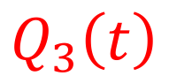
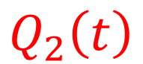
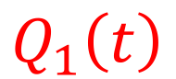
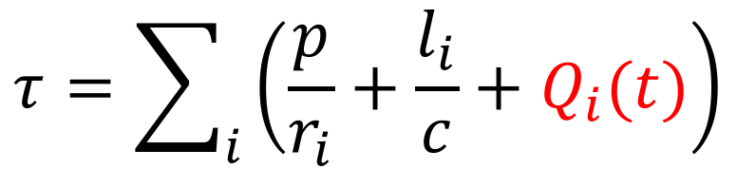
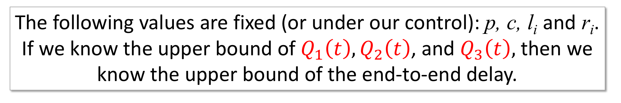
Delay guarantees: Intuition
A
l₁, r₁
l₂, r₂
l₃, r₃
l₄, r₄
B
$$Q_{1}\left(t\right)$$
$$Q_{2}\left(t\right)$$
$$Q_{3}\left(t\right)$$
$$τ=\sum_{i}{\left(\frac{p}{r_{i}}+\frac{l_{i}}{c}+Q_{i}(t)\right)}$$
End-to-end delay,
The following values are fixed (or under our control): p, c, l_{i} and r_{i}.
If we know the upper bound of $Q_{1}\left(t\right), Q_{2}\left(t\right)$, and $Q_{3}\left(t\right),$ then we know the upper bound of the end-to-end delay.
Notes:
I'm going to start by giving you the intuition for how it works. Here is our network of packet switches again, from an earlier video. End Host A sends packet to End Host B over 4 links and through three packet switches. You’ll remember the equation for the end to end delay,
Tau equals the sum of the packetization delay p over r I, the propagation delay L I over c and the queueing delay…. across the network.
The only variable portion of the delay is the queueing delay in each switch, caused by other flows sharing the queues with our packets. And so if we want to guarantee an upper bound on the delay across the network, we need to bound the queueing delay in each swtich.
The intuition behind it is as follows: The following value are fixed (or under our control): p, c, l_{i} and r_{i}.
If we know the upper bound of $Q_{1}\left(t\right), Q_{2}\left(t\right)$, and $Q_{3}\left(t\right),$ then we know the upper bound of the end-to-end delay.
We are going to use the fact that we can guarantee the rate of a flow to bound the queueing delay it experiences in each packet switch along the way.

Slide 42

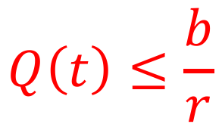
Upper bound on $Q\left(t\right)$
b
r
$$Q\left(t\right)≤\frac{b}{r}$$
Example: If a packet arrives to a FIFO queue of size 1 million bits, and the queue is served at 1Gb/s, then the packet is guaranteed to depart within ${{10}^{6}}/{{10}^{9}}=1$ms.
Notes:
By making the following simple observation: <click> If a queue of size b is full of packets, and the queue is served at rate r, then the time it takes to drain the queue is b over r. It means that when a packet arrives to the queue, if the queue is served in FIFO order, then the packet can’t possibly be delayed by the queue for more than b over r seconds.
Before moving on, make sure you understand this observation and can see why this is true. It’s the key idea behind giving delay guarantees, and without feeling comfortable with it, the rest of the video won’t make much sense.
As a numeric example <click to show example>, imagine a packet arrives to a FIFO queue of size 1 million bits, and the queue is served at 1Gb/s, then the packet is guaranteed to depart within 10^6 divided by 10^9 seconds, which is 1 ms. The maximum delay through the queue is 1ms.

Slide 43
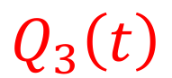
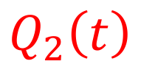
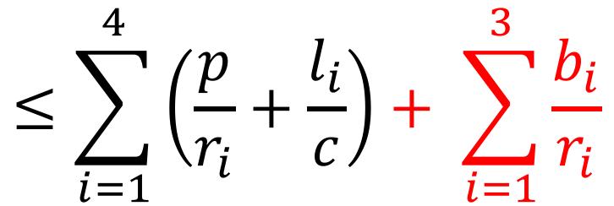
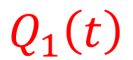
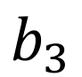
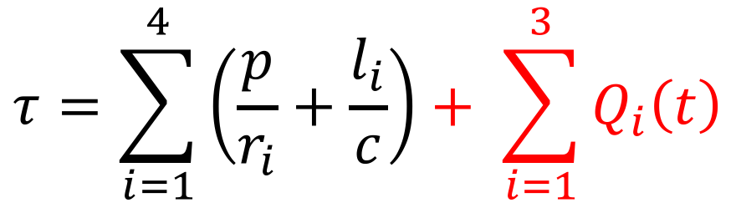
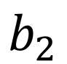
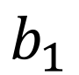
Delay guarantees: Intuition
$$b_{1}$$
$$b_{2}$$
$$b_{3}$$
A
l₁, r₁
l₂, r₂
l₃, r₃
l₄, r₄
B
$$Q_{1}\left(t\right)$$
$$Q_{2}\left(t\right)$$
$$Q_{3}\left(t\right)$$
$$τ=\sum_{i=1}^{4}{\left(\frac{p}{r_{i}}+\frac{l_{i}}{c}\right)+ \sum_{i=1}^{3}{Q_{i}\left(t\right)}}$$
End-to-end delay for a single packet,
$$≤\sum_{i=1}^{4}{\left(\frac{p}{r_{i}}+\frac{l_{i}}{c}\right)+ \sum_{i=1}^{3}{\frac{b_{i}}{r_{i}}}}$$
Notes:
This is easily extended to a packet passing through a network of switches, where we know the size of each queue and the rate at which it is served.
In this example, imagine a network that is completely idle, with no other packets in it. We send a sequence of packets from A to B along exactly the same path, through the same queues shown here.
Our single packet will have an end to end delay bounded by this formula: The sum of the fixed delay over four links, plus the upper bound on how long it takes to go through the three router queues of size b1, b2 and b3.

Slide 44
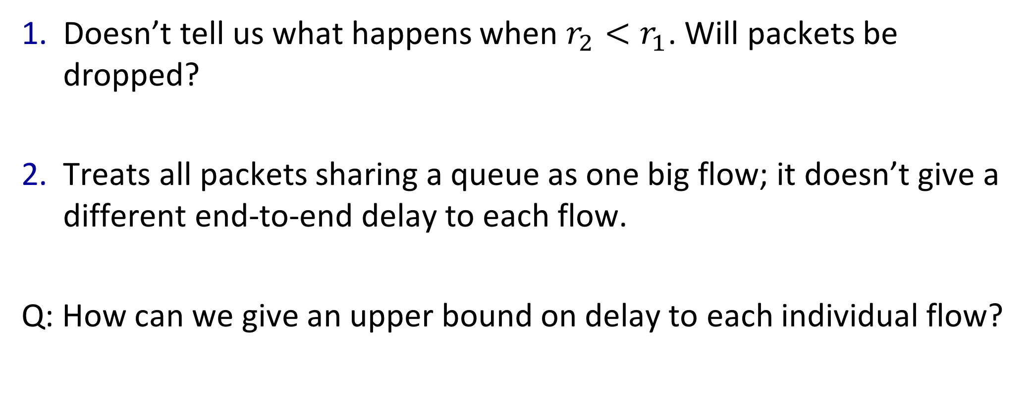
Why this is only an intuition…
Doesn’t tell us what happens when $r_{2}<r_{1}$. Will packets be dropped?
Treats all packets sharing a queue as one big flow; it doesn’t give a different end-to-end delay to each flow.
Q: How can we give an upper bound on delay to each individual flow?
Notes:
The result takes us only so far. It doesn’t tell us what happens when the second link is slower than the first, causing packets to back up in the queue. If the queue is full when a packet arrives, is the packet dropped? If so, we haven’t done a very good job controlling the delay of our packet across the network if it gets dropped on the floor.
Second, it treats all packet sharing a queue as one big flow. In practice, an egress link has packets from many different inputs. If they all share the same queue, then we can’t say much about the experience for one individual flow.
So our next question is: How can we give an upper bound on delay to each and every individual flow in the network?

Slide 45
Weighted Fair Queueing (WFQ)
𝜙₁
Packets arriving to different ingress ports
𝜙_{i}
Classify packets into flows
Packet scheduler
R
∑𝜙_{i} = 1
𝜙_{N}
_{i}
Flow i is guaranteed to receive at least rate
𝜙_{i}R
Notes:
You probably guessed it: We are going to use Weighted Fair Queueing again.

Slide 46
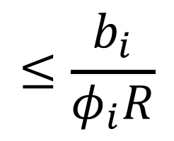
Weighted Fair Queueing (WFQ)
𝜙₁
b_{i}
Packets arriving to different ingress ports
𝜙_{i}
Classify packets into flows
Packet scheduler
R
∑𝜙_{i} = 1
𝜙_{N}
_{i}
$$≤\frac{b_{i}}{φ_{i}R}$$
delay
Flow i is guaranteed to receive at least rate
𝜙_{i}R
Notes:
If we create a queue for each flow, and if we know the size of the queue, then we can bound the delay through the queue. For example, the packets for the blue flow are placed in a queue of size b i, and the queue is served at rate fai i times R. It means the delay <click> for all the packets in the flow, through this router, is no more b I over fai I times R.

Slide 47
Bounding end-to-end delay
Notes:
We can now create a simple example for how we bound the delay for a flow of packets across a network of WFQ routers.

Slide 48
Bounding end-to-end delay
Allocate a queue of size b for this flow
Assign a WFQ service rate of𝜙R
b
b
𝜙R
𝜙R
l
l
l
l
b
𝜙R
The end-to-end delay of a single packet of length p $≤4\left(\frac{l}{c}+\frac{p}{R}\right)+3\frac{b}{\text{φ}\text{R} }$
Notes:
First we can allocate a queue of size b in each of the routers along the path, served at rate fai times R using WFQ. This gives us a simple expression for the end to end delay for packets belonging to the flow. No matter what other traffic is in the network, so long as this queue is served at rate fai times R, then the end to end delay is bounded.

Slide 49
What if two of the flow’s enter the network back-to-back? (A “burst”)
If the packets are far apart, then the queues drain the first packet before the second one arrives. All is good, and the delay equation holds.
If the packets are close together in a “burst”, then they can arrive faster than 𝜙R and the queue might overflow, dropping packets.
This might be OK in some cases. But if we want to bound the end-to-end delay of all packets, then we need to deal with bursts. How?
Notes:
I want to get back to this question of packets being dropped when a queue overflows.
If the packets are far apart, then the queues drain the first packet before the second one arrives. All is good, and the delay equation holds.
But… If the packets are close together in a “burst”, then they can arrive faster than 𝜙R and the queue might overflow, dropping packets.
This might be OK in some cases. But if we want to bound the end-to-end delay of all packets, then we need to deal with bursts. How?
We are going to control the burstiness when the packets are sent by End Host A into the network using something called a....

Slide 50
The leaky bucket regulator Limiting the “burstiness”
Tokens at
constant rate, ρ
Token bucket
size, σ
Packets In
Packets Out
Send packet if and only if we have tokens in the bucket
Notes:
….leaky bucket regulator, shown here. First I will explain what a leaky bucket regulator is, then I will show you how we can use it to limit the burstiness of packets entering the network.
At the bottom is a packet FIFO. The basic rule is that we can send a packet if and only if we have tokens in the bucket. We need enough tokens for the number of bits in the packet. Now look at the token bucket. TOkens are put into the bucket at a constant rate, rho. We keep adding them until they are used by departing packets, or until the token bucket fills up. If the bucket is full, new tokens are dropped on the floor.

Slide 51
The leaky bucket regulator Limiting the “burstiness”
Tokens at
constant rate, ρ
Token bucket
size, σ
Packets In
Packets Out
Send packet if and only if we have tokens in the bucket
Notes:
Imagine the token bucket is empty and has no tokens in it right now. If a packet arrives <click>, it must wait for sufficient tokens to send the data in the packet. Let’s assume we need two tokens to send this blue packet. As soon as we have enough tokens, the packet can depart. Notice that the tokens are consumed when the packet departs and there are no tokens left after it has left.

Slide 52
The leaky bucket regulator Limiting the “burstiness”
Tokens at
constant rate, ρ
Token bucket
size, σ
Packets In
Packets Out
Send packet if and only if we have tokens in the bucket
Notes:
Now if *two* packets arrive back to back in a burst, the constant drip-drip rate of tokens into the bucket will spread the two packets out. Once again, the first packet leaves as soon as we have two tokens in the bucket. But the second packet has to wait until two new tokens arrive before it could leave.
Notice that we can control the departure rate of the packets by picking the rate at which tokens are placed into the bucket. And we can control the maximum size of a burst of packets that can depart at the same time, by controlling how big the bucket is.

Slide 53
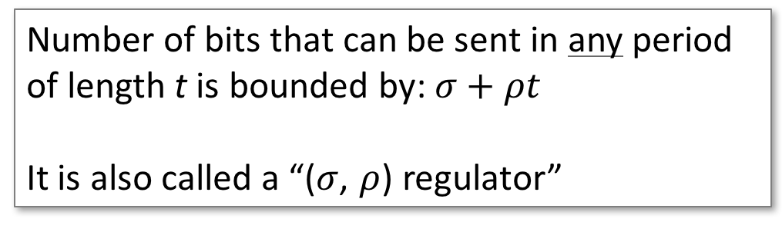
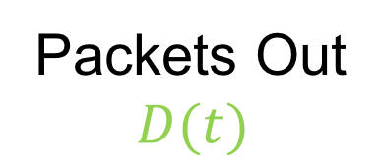
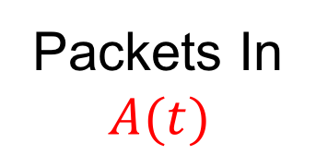
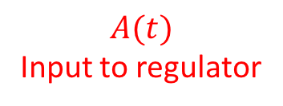
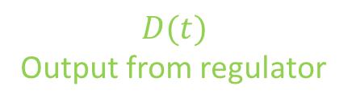
The leaky bucket regulator
ρ
$$A(t)$$
Input to regulator
ρ
Cumulative
bits
σ
σ
Packets In
$$A(t)$$
Packets Out
$$D(t)$$
$$D(t)$$
Output from regulator
Number of bits that can be sent in any period of length t is bounded by: $σ+ρt$
It is also called a “($σ$, $ρ$) regulator”
time
Notes:
Put more precisely, the leaky bucket regulator makes sure that the number of bits that can be sent in any period of length t is bounded by: $σ+ρt$
Another name for a leaky bucket regulator is a "sigma rho regulator" for this reason, and by convention we use rho to refer to the long term rate and sigma the maximum size of a burst.
Let’s look at what a sigma rho regulator does to an arrival process, A(t) shown here <click>. Let’s assume this is the cumulative arrival of bits to the regulator over time. We can represent the sigma rho regulator by a blue line like this, starting at any point in time. Starting from any point in time, the regulator will constrain the output process to fall below the blue line, because it won't allow an instantaneous burst of more than sigma and a long-term rate of more than rho. <click> In green is the output from the regulator, showing how red arrivals are delayed in the regulator until they can depart. And now we have placed a bound on how bursty the output is from the regulator.

Slide 54
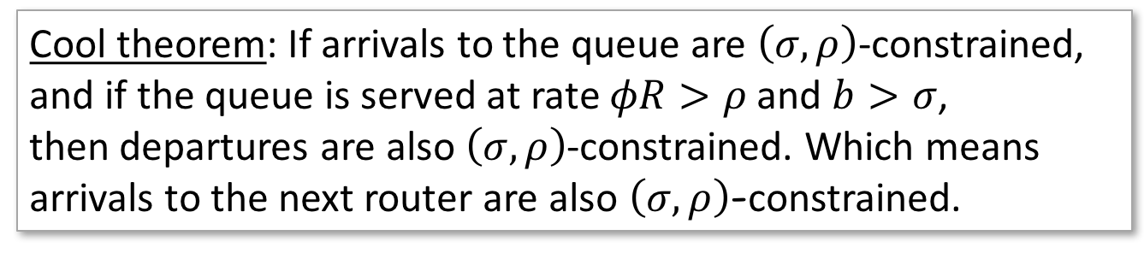
The leaky bucket regulator Limiting the “burstiness”
ρ
Cool theorem: If arrivals to the queue are $\left(σ,ρ\right)$-constrained,
and if the queue is served at rate $φR>ρ$ and $b>σ$,
then departures are also $\left(σ,ρ\right)$-constrained. Which means
arrivals to the next router are also $\left(σ,ρ\right)$-constrained.
σ
b
b
𝜙R
𝜙R
If $φR>ρ$ and $b>σ$ then delay through the first router for all packets in the flow $≤\frac{b}{\text{φ}\text{R} }$
Notes:
Let's see how we use the leaky bucket regulator in practice. The end host contains a leaky bucket regulator, implemented in software or in hardware. It guarantees that the packets the host is sending into the network are sigma-rho constrained. If the buffer at the first router can hold up to b bits, then we need to make sure the packets leaving the end host are sufficiently regulated that they can't make the buffer overflow. This means the rate at which the buffer is served, fai times R, must be faster than the rate at which the end host sends bits into the network. In other words, we need fair times R greater than rho. If we also make b greater than sigma, then we can be sure the buffer can absorb the largest burst the end host will send. And if we make sure both of these properties are true, then we can be sure no packets are dropped and the delay through the first router is no more than b over fai times R seconds.
<click> What happens when the packets from the first router reach the second router along the path? Can we be sure the packets won't become bursty again, and overflow the second router?
Yes, we can be sure. <click> THere is a very cool theorem that says: If arrivals to the queue are $\left(σ,ρ\right)$-constrained,
and if the queue is served at rate $φR>ρ$ and $b>σ$,
then the departures from the router are also $\left(σ,ρ\right)$-constrained. Which means
arrivals to the next router are also $\left(σ,ρ\right)$-constrained too.
And so the delay through the second router is also guaranteed to be less than b over fai times R as well!

Slide 55
Putting it all together
ρ
σ
b
b
l
𝜙R
𝜙R
l
l
b
l
𝜙R
If $φR>ρ$ and $b>σ$ then the end-to-end delay of every packet of length p $≤4\left(\frac{l}{c}+\frac{p}{R}\right)+3\frac{b}{\text{φ}\text{R} }$
Notes:
Let’s put it all together.
If the end host has a leaky bucket regulator, and if every router uses Weighted Fair Queueing, then we can guarantee an upper bound on the end to end delay as follows:
<click> If $φR>ρ$ and $b>σ$ then the end-to-end delay of every packet of length p $≤4\left(\frac{l}{c}+\frac{p}{R}\right)+3\frac{b}{\text{φ}\text{R} }$

Slide 56
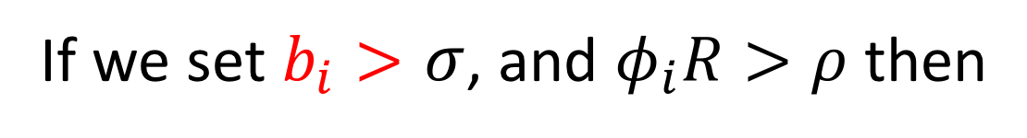
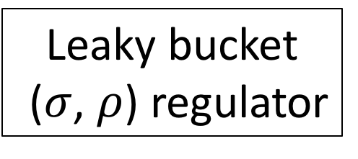

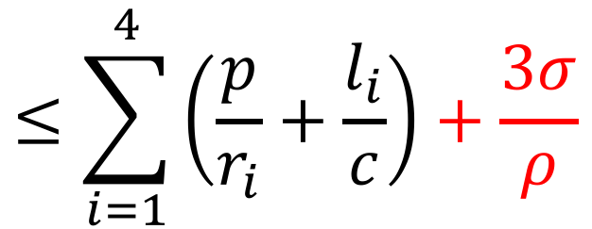
In other words
Leaky bucket ($σ$, $ρ$) regulator
b₁
b₂
b₃
𝜙₁R
𝜙₂R
𝜙₃R
A
l₁, r₁
l₂, r₂
l₃, r₃
l₄, r₄
B
$$Q_{1}\left(t\right)$$
$$Q_{2}\left(t\right)$$
$$Q_{3}\left(t\right)$$
$$τ=\sum_{i=1}^{4}{\left(\frac{p}{r_{i}}+\frac{l_{i}}{c}\right)+ \sum_{i=1}^{3}{Q_{i}\left(t\right)}}$$
If we set $b_{i}>$ $σ$, and $φ_{i}R>ρ$ then
$$≤\sum_{i=1}^{4}{\left(\frac{p}{r_{i}}+\frac{l_{i}}{c}\right)+\frac{3σ}{ρ}}$$
Notes:
In other words, in our original example, if we set b i greater than sigma and fai i times R greater than rho, then we have a simple upper bound on the end to end delay as shown.

Slide 57
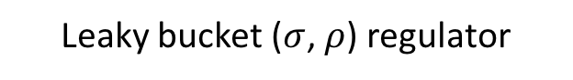
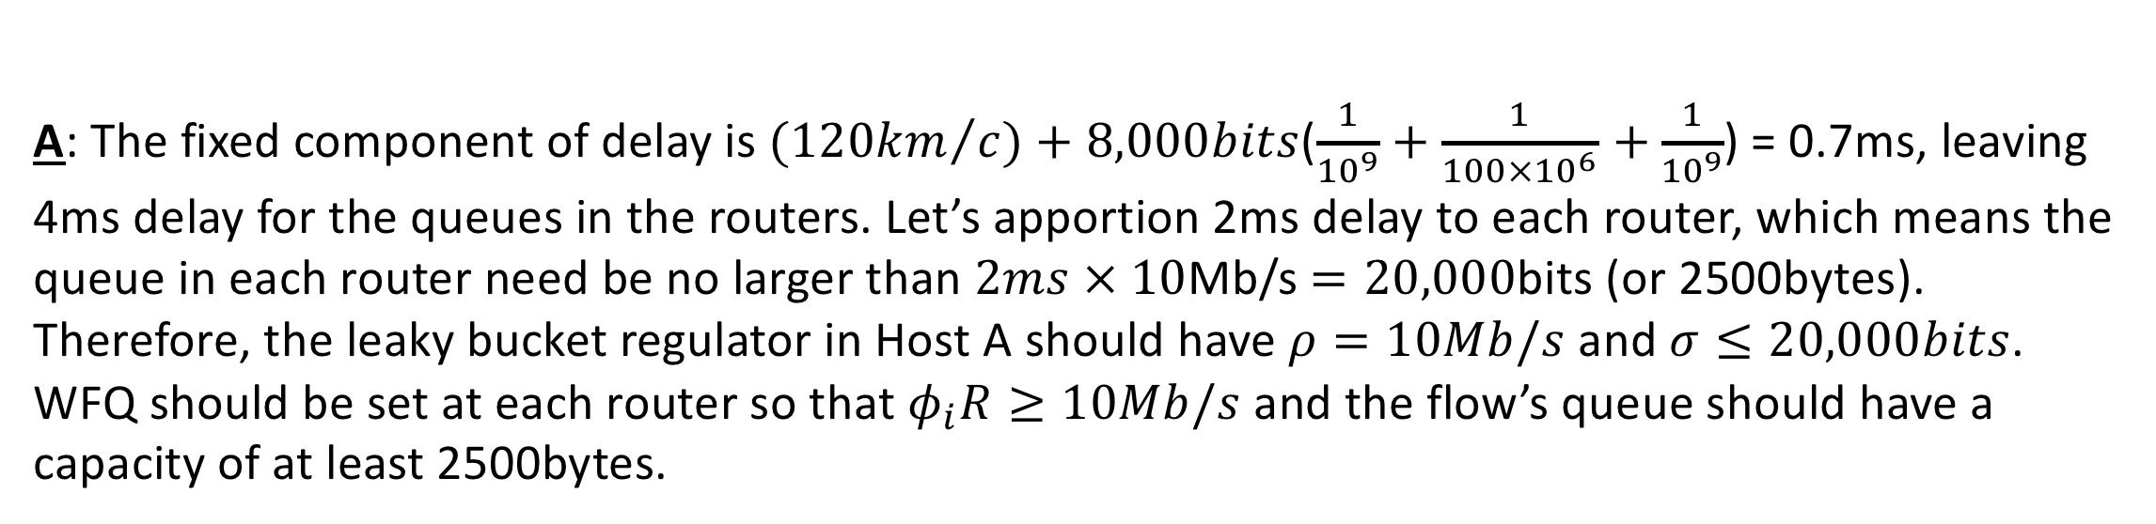
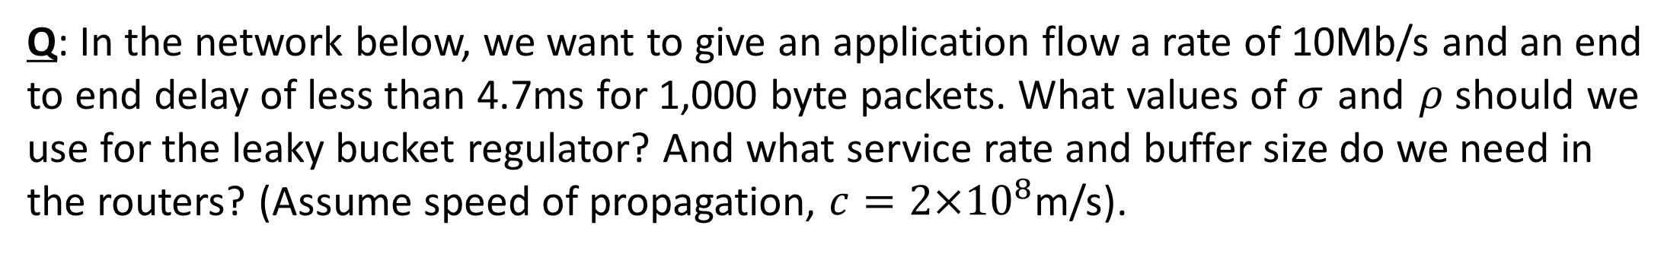
An Example
Q: In the network below, we want to give an application flow a rate of 10Mb/s and an end to end delay of less than 4.7ms for 1,000 byte packets. What values of $σ$ and $ρ$ should we use for the leaky bucket regulator? And what service rate and buffer size do we need in the routers? (Assume speed of propagation, $c=2{×10}^{8}$m/s).
Leaky bucket ($σ$, $ρ$) regulator
A
10km, 1Gb/s
100km, 100Mb/s
10km, 1Gb/s
B
A: The fixed component of delay is ${(120km}/c)+8,000bits$($\frac{1}{{10}^{9}}+\frac{1}{{100×10}^{6}}$ $+\frac{1}{{10}^{9}}$) = 0.7ms, leaving 4ms delay for the queues in the routers. Let’s apportion 2ms delay to each router, which means the queue in each router need be no larger than $2ms × 10$Mb/s $=20,000$bits (or 2500bytes). Therefore, the leaky bucket regulator in Host A should have $ρ=10Mb/s$ and $σ≤20,000bits$. WFQ should be set at each router so that $φ_{i}R≥10Mb/s$ and the flow’s queue should have a capacity of at least 2500bytes.
Notes:
Let’s look at a numeric example.
In the network below, we want to give an application flow a rate of 10Mb/s and an end to end delay of less than 4.7ms for 1,000 byte packets. What values of $σ$ and $ρ$ should we use for the leaky bucket regulator? And what service rate and buffer size do we need in the routers? We are going to assume a speed of propagation, $c=2{×10}^{8}$m/s.
Here is the answer:
The fixed component of delay – in other words, all of the delay except for the queueing delay – is given by ${(120km}/c)+8,000bits$($\frac{1}{{10}^{9}}+\frac{1}{{100×10}^{6}}$ $+\frac{1}{{10}^{9}}$) = 0.7ms. This leaves 4ms delay for the queues in the routers. We can apportion the delay between the routers however we want, so long as we can make the numbers work. Let’s make it simple and apportion 2ms delay to each router, which means the queue in each router should be no larger than $2ms × 10$Mb/s $=20,000$bits (or 2.5Kbytes). Therefore, the leaky bucket regulator in Host A should have $ρ=10Mb/s$ and $σ≤20,000bits$. WFQ should be set at each router so that $φ_{i}R≥10Mb/s$ and the flow’s queue should have a capacity of at least 2.5Kbytes.
If any part of the example doesn’t make sense, go back through the video and hopefully it will become clear.

Slide 58
In practice
While almost all network equipment implements WFQ (even your WiFi router at home might!), public networks don’t provide a service to control end-to-end delay.
Why?
It requires coordination of all the routers from end to end.
In most networks, a combination of over-provisioning and priorities work well enough.
Notes:
So how is this result used in practice? Does my home router guarantee the end to end delay of my packets?
Sadly not. While almost all network equipment implements WFQ (even your WiFi router at home might!), public networks don’t provide a service to control end-to-end delay.
Why? It turns out that it requires all the different network owners – folks like AT&T, Verizon, Telefonica, China Mobile, Vodafone to all agree upon how to apportion the delay to each router, and how to signal all the information the end host needs to calculate the leaky bucket and WFQ parameters. There is, in fact, a standard mechanism to do all this, called the Resource Reservation Protocol, or RSVP. But to deploy it would require quite a big departure from how the Internet has been built up until this point. Technically, it would work. But it doesn’t really fit with the business practices of large Internet providers, who arent’ really set up to share this kind of fine grain control with their neighboring providers, or with us, the consumers.
Luckily, In most networks, a combination of over-provisioning and priorities work well enough. What I mean by this is that the Internet is designed to carry more traffic than it actually does, which means most of the time the queues are kept quite small. With some strict priorities for control traffic to keep the network humming along, it works quite well. But in future, if it becomes too expensive or impractical to over provision the Internet, we might need rate and delay mechanisms described in the previous two videos.

Slide 59
Summary
If we know the size of a queue and the rate at which it is served, then we can bound the delay through it.
WFQ allows us to pick the rate at which a queue is served.
With the two observations above, if no packets are dropped, we can control end-to-end delay.
To prevent drops, we can use a leaky bucket regulator to control the “burstiness” of flows entering the network.
Notes:
And so in summary….
If we know the size of a queue and the rate at which it is served, then we can bound the delay through it.
WFQ allows us to pick the rate at which a queue is served.
With the two observations above, if no packets are dropped, we can control end-to-end delay.
To prevent drops, we need a leaky bucket regulator to control the “burstiness” of flows entering the network.
Now you know how to limit the end to end delay of a packet through a packet switched network.

